Slide 1



From LIBOR's Legacy to Risk-Free Rates
An Analysis of Global Interest Rate Benchmarks
by Pearlyn Rodrigues

Slide 2
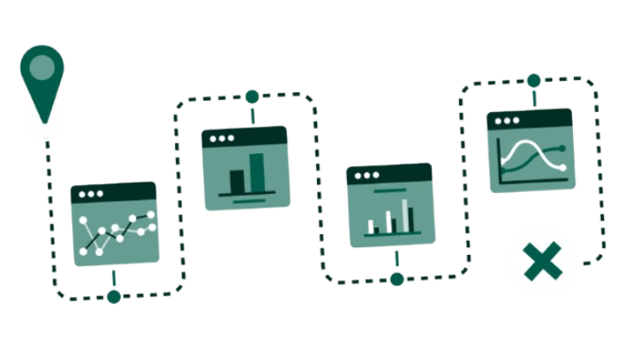
Benchmark Interest Rates & Post-LIBOR Transition
Rates have shifted post-LIBOR: Global transition from LIBOR to Risk-Free Rates (RFRs) completed in major markets
Transition gaining momentum: SOFR dominates USD markets, SONIA leads GBP, ESTR for EUR
Regional significance: Different rates serve different markets - MCLR/RLLR in India, TONAR in Japan
Impact on pricing/hedging: Fundamental changes in credit valuation, discounting methodologies, and risk management
Market Impact Snapshot: The transition from LIBOR to RFRs represents one of the most significant changes in financial markets since the 2008 crisis. This shift affects over $400 trillion in financial contracts globally and requires fundamental changes in pricing, valuation, and risk management practices.

Slide 3
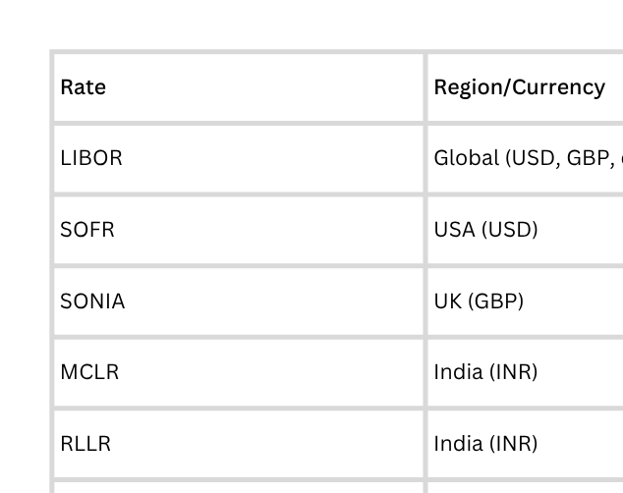
Popular Interest rates

Slide 4
LIBOR - The Legacy Benchmark
London Interbank Offered Rate (LIBOR)
Definition & Region: Global benchmark representing the rate at which major banks lend to each other
Publisher: ICE Benchmark Administration (IBA) - formerly British Bankers' Association
Methodology: Unsecured, forward-looking, based on panel bank submissions
Tenor Availability: Overnight, 1 week, 1, 2, 3, 6, 12 months
Currencies: USD, GBP, EUR, JPY, CHF
Historical Significance
LIBOR was once called "the world's most important number" - underpinning over $400 trillion in financial contracts including loans, mortgages, derivatives, and bonds.
Transition Status
LIBOR publication ceased for most currencies on December 31, 2021. USD LIBOR continued until June 30, 2023, with synthetic rates available for tough legacy contracts.

Slide 5
SOFR - The USD Risk-Free Rate
Secured Overnight Financing Rate (SOFR)
Definition & Region: USD risk-free rate based on overnight Treasury repo transactions
Publisher: Federal Reserve Bank of New York
Methodology: Secured, backward-looking, transaction-based
Tenor Availability: Overnight (primary), with 30, 90, 180-day term rates
Underlying Market: ~$1.7 trillion daily Treasury repo transactions
Key Advantages
Based on actual transactions, not estimates
Secured by US Treasury collateral (virtually risk-free)
Robust underlying market with high liquidity
Transparent methodology and governance
Market Adoption
SOFR derivatives trading has grown exponentially, with daily volumes exceeding $200 billion in interest rate swaps by 2024.

Slide 6
SONIA & ESTR - European RFRs
Sterling Overnight Index Average (SONIA)​
Euro Short-Term Rate (ESTR)​
Sterling Overnight Index Average (SONIA)​
Region: United Kingdom (GBP)​
Publisher: Bank of England​
Methodology: Unsecured, backward-looking, based on overnight deposits​
SONIA existed before the 2008 crisis but was revived and enhanced as LIBOR replacement​ achieved a 22.9% revenue increase over the past fiscal year, exceeding projections.​
Region: Eurozone (EUR)​
Publisher: European Central Bank (ECB)​
Methodology: Unsecured, backward-looking, based on overnight lending​
Market Basis: Wholesale euro unsecured overnight borrowing​
Regional Adoption Patterns
SONIA: Strong adoption in GBP swaps, bonds, and syndicated loans
ESTR: Gradual adoption alongside EURIBOR in European markets
Both rates show lower volatility compared to their respective LIBOR equivalents

Slide 7
Asian Markets benchmark
Tokyo Overnight Average Rate (TONAR)
Indian Benchmark Transition: MCLR to RLLR
Region: Japan (JPY)
Publisher: Bank of Japan
Methodology: Unsecured, backward-looking, call market based
Characteristics: Low volatility, reflects BoJ's ultra-accommodative policy
MCLR (Marginal Cost of Funds-based Lending Rate):
Internal benchmark based on bank's cost of funds
Less transparent, slower transmission of policy rates
RLLR (Repo Linked Lending Rate):
External benchmark linked to RBI's repo rate
More transparent, faster policy transmission
~70% of new retail loans now use RLLR-linked pricing

Slide 8
Euro Interbank Offered Rate (EURIBOR)
Definition: Rate at which eurozone banks lend to each other
Publisher: European Money Markets Institute (EMMI)
Methodology: Unsecured, forward-looking, hybrid (transaction + expert judgment)
Tenor Availability: 1 week, 1, 3, 6, 12 months
Status: Reformed and strengthened, remains active
Why EURIBOR Survived
Successful reform program addressing regulatory concerns
Hybrid methodology combining transactions and expert judgment
Strong governance and oversight framework
Deep integration in European financial markets
Coexistence strategy with ESTR rather than full replacement
EURIBOR continues to play a significant role in European derivatives markets, particularly for term rates. It coexists with ESTR, with ESTR serving as the risk-free rate for discounting and EURIBOR maintaining its role in forward-looking products.

Slide 9
Historical Trends Analysis (2023-2025)
Key Rate Movements - Last 2 Years
Major Trends and Inflection Points:
LIBOR Cessation (June 2023): Final USD LIBOR settings published, marking end of an era
SOFR/SONIA Rate Hikes: Both rates climbed significantly with Federal Reserve and Bank of England tightening cycles, reaching multi-year highs
TONAR Stability: Remained near zero, reflecting Bank of Japan's ultra-accommodative monetary policy stance
MCLR vs RLLR Divergence: Indian rates showed clear divergence as RLLR responded faster to RBI policy changes
EURIBOR Tightening: Rose alongside ECB policy normalization, reflecting eurozone banking sector conditions

Slide 10
Conclusion
Resilience in Uncertainty: Despite elevated rates and policy divergence, global markets have demonstrated remarkable resilience, adapting to a “higher for longer” environment without widespread instability.
Transparency & Trust: The shift from legacy benchmarks like LIBOR to transparent, transaction-based rates (SOFR, SONIA, €STR, TONAR) has strengthened market credibility and reduced systemic risk.
Divergence Brings New Challenges: As central banks chart different paths, localized risks and capital flow volatility have increased, making active risk management and regional understanding more important than ever.
Credit Risk Evolution: With risk-free rates lacking embedded credit risk premiums, lenders must adapt their pricing strategies, and borrowers must be prepared for more dynamic interest costs.
Looking Ahead: The global financial system is better equipped for future shocks, but vigilance is essential. Monitoring basis risk, policy shifts, and market liquidity will remain crucial for financial stability.

